Slide 1
Forest Fire Detection
Deep Learning project
By: Amirah, Amal, Alanoud

Slide 2
Introduction
wildfire conditions are becoming more extreme and increasingly reflect rising global temperatures.
As the planet continues to rapidly warm, wildfires will become a growing problem. Consequently, the fires are not just local problems; they pose international challenges..

Slide 3
Goals
- Help our Government especially General Directorate of Civil Defense in Rapid detection of forest fire
to reduce casualties and property losses.
- Doing a fire warning alert if the live camera see the fire.

Slide 4
Workflow
01
02
03
Load Data
Process image
Split Data
04
05
06
Model
Evaluation
Demo

Slide 5
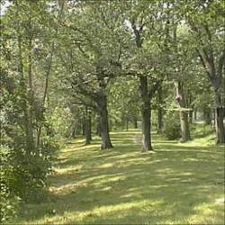
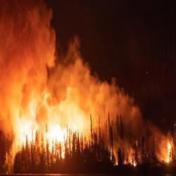
Dataset
Data contains 5050 images of Fire and Non Fire combined.

Slide 6
Tools
cv2
NumPy
Demo
Linear algebra
Matplotlib
Keras
Pygame
Data visualization
Model
For alert sound

Slide 7
Results
50 Epoch | Accuracy | Loss
Train | 0.937 | 0.168
Test | 0.945 | 0.155

Slide 8
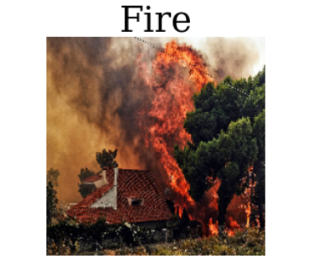
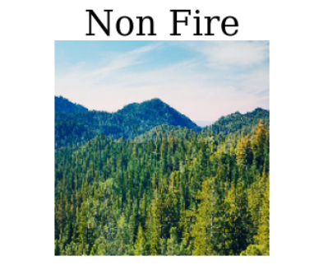
Predict Results

Slide 9
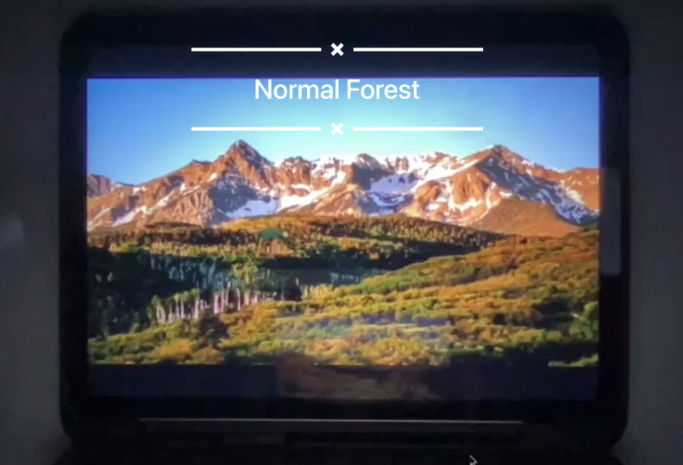
Demo

Slide 10
Future Work
Load large dataset
Improve Demo
Improve model
Recognize smoke

Slide 11
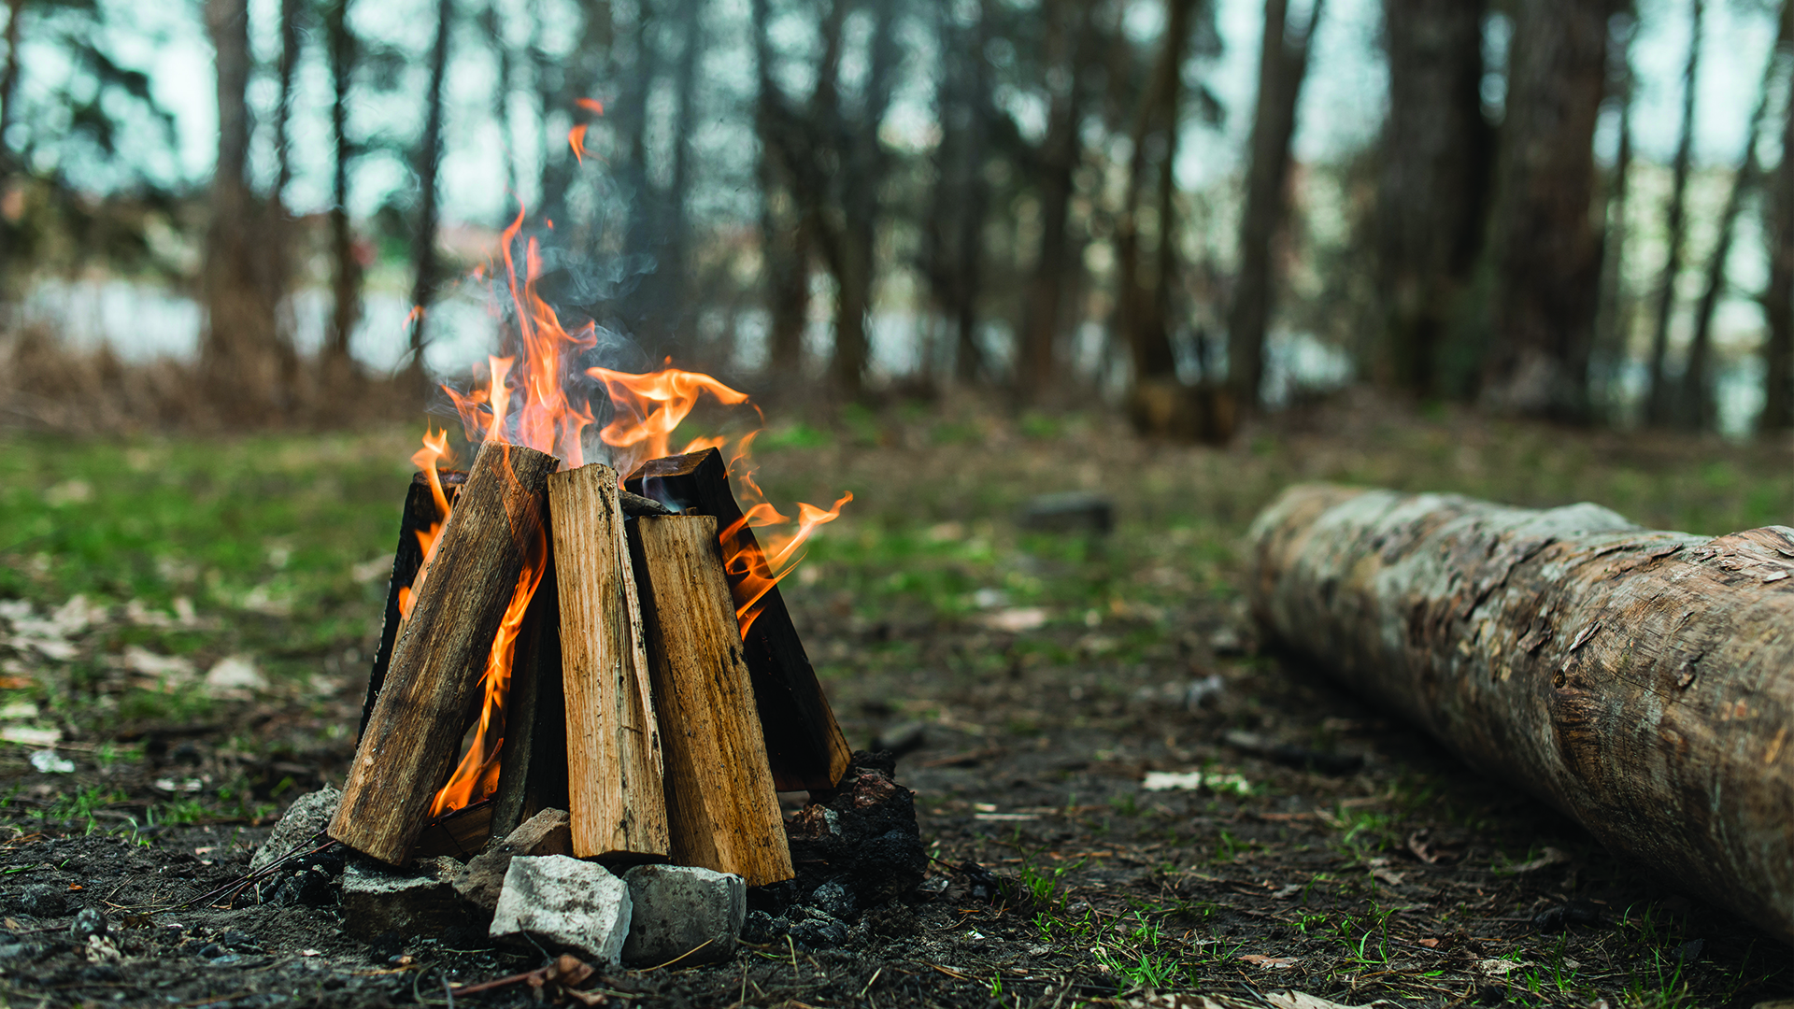
Thank you

